Slide 1

Garda Vetting
Approved ID Verifier Training

Slide 2

Welcome!
How to Verify ID Documents & NVB forms
Accepted forms of Photo ID
Accepted forms of Proof of Address
Vetting for under-18s
ID Verification Form

Slide 3
Verifying Documents
All documents must be seen in-person
Applicant must produce original documents on day of verification
Cannot accept photos, screenshots or scans of documents
ID Verifiers take copies of ID and proof of address on the day of verification
Proof of Address documents must be printed

Slide 4
Verifying Documents
All applicants need to bring each of the following:
1
2
3
NVB1 Form
Photo ID
Proof of Address

Slide 5
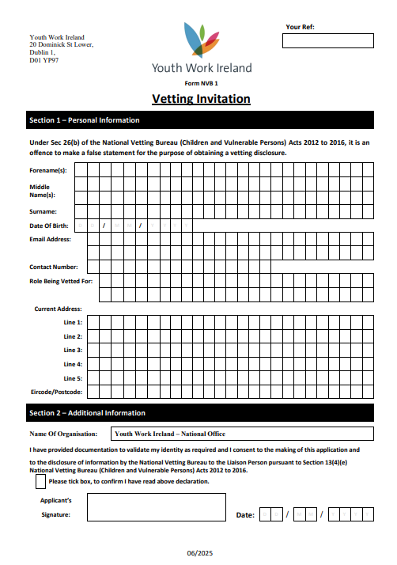
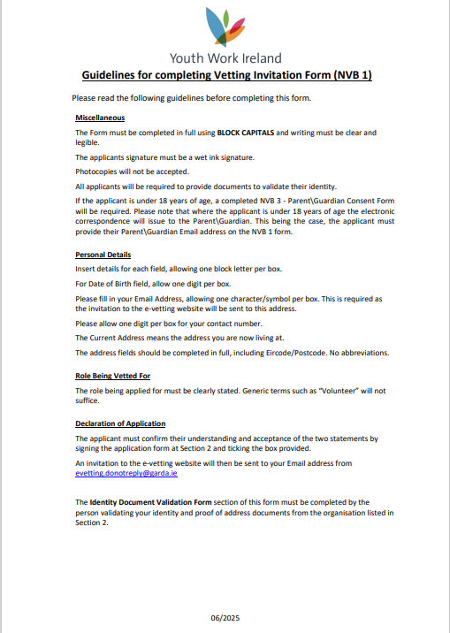
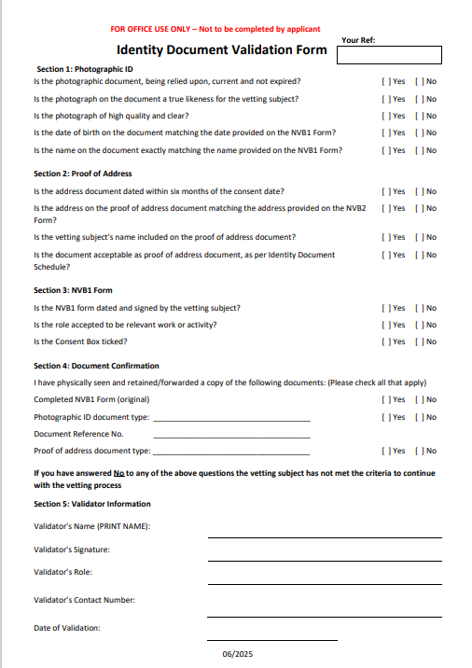
The NVB1 Form

Slide 6
Verifying an NVB1 Form
Wet Signature
Consent box ticked
Date of consent
Role Being Vetted For
Organisation Name
Matching Details

Slide 7
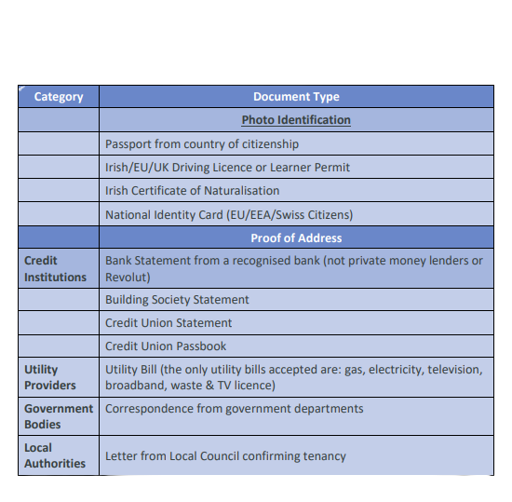
Acceptable Photo IDs
These are the only forms of photo ID we can accept

Slide 8
Verifying Photo ID
Photo is clear & high quality
Photo matches the person in front of you
Document is valid & in-date
Name on photo ID exactly matches name on NVB1 form
Date of birth on photo ID exactly matches date of birth on NVB1 form

Slide 9
Acceptable Proof of Address
These are the only forms of proof of address we can accept

Slide 10
Additional Info
Cannot accept:
Revolut Statements
Mobile Phone Bills
Letters from Government Agencies
e.g. HSE, NDLS, Intreo
Letters from Hotel or Direct Provision Centre Manager
Must be from IPAS directly

Slide 11
Verifying Proof of Address
Document has date clearly shown
Date issued within 6 months of date of consent on NVB1 form
Address is applicant’s current address
Name on document exactly matches name on NVB1 form and Photo ID
Address on document exactly matches address on NVB1 form

Slide 12
Vetting for Under 18s
NVB will not process vetting for anyone under the age of 16
All 16- and 17-year-old applicants must also have an NVB3 form
NVB3 form is the Parent/Guardian consent form, and must include Parent/Guardian contact details

Slide 13
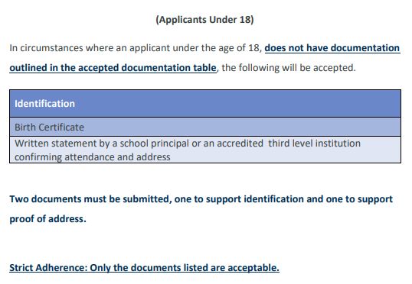
ID Verification for under-18s

Slide 14
Verification Form
Only those who have completed this training may sign the verification form
By signing the form, you are stating that you have carried out the relevant checks adequately and accurately
There is an element of legal liability involved in this process
See Section 26 & 27 of National Vetting Bureau (Children and Vulnerable Persons) Act 2012

Slide 15





Your Ref:
20 Dominick St Lower, Dublin 1, D01 YP97
FormNVB 1
Vetting Invitation
Section 1 – Personal Information
Under Sec 26(b) of the National Vetting Bureau (Children and Vulnerable Persons) Acts 2012 to 2016, it is an
offence to make a false statement for the purpose of obtaining a vetting disclosure.
Forename(s):
Middle
Name(s):
Surname:
Date Of Birth:
Email Address:
D
D
/
M
M
/
Y
Y
Y
Y
Contact Number: Role Being Vetted For:
Current Address:
Line 1: Line 2: Line 3: Line 4: Line 5: Eircode/Postcode:
Section 2 – Additional Information
Name Of Organisation:
Carlow Regional Youth Service
I have provided documentation to validate my identity as required and I consent to the making of this application and
to the disclosure of information by the National Vetting Bureau to the Liaison Person pursuant to Section 13(4)(e)
National Vetting Bureau (Children and Vulnerable Persons) Acts 2012 to 2016.
Please tick box, to confirm I have read above declaration.
Applicant’s
Signature:
Date:
D
D
/ M
M
/
Y
Y
Y
Y
06/2025

Slide 16

FOR OFFICE USE ONLY – Not to be completed by applicant
Your Ref:
Identity Document Validation Form
Section 1: Photographic ID
Is the photographic document, being relied upon, current and not expired?
Is the photograph on the document a true likeness for the vetting subject?
Is the photograph of high quality and clear?
Is the date of birth on the document matching the date provided on the NVB1 Form?
Is the name on the document exactly matching the name provided on the NVB1 Form?
[ ] Yes
[ ] Yes
[ ] Yes
[ ] Yes
[ ] Yes
[ ] No
[ ] No
[ ] No
[ ] No
[ ] No
Section 2: Proof of Address
Is the address document dated within six months of the consent date?
Is the address on the proof of address document matching the address provided on the NVB1
Form?
Is the vetting subject's name included on the proof of address document?
Is the document acceptable as proof of address document, as per Identity Document Schedule?
[ ] Yes
[ ] Yes
[ ] No
[ ] No
[ ] Yes
[ ] Yes
[ ] No
[ ] No
Section 3: NVB1 Form
Is the NVB1 form dated and signed by the vetting subject?
Is the role accepted to be relevant work or activity?
Is the Consent Box ticked?
[ ] Yes
[ ] Yes
[ ] Yes
[ ] No
[ ] No
[ ] No
Section 4: Document Confirmation
I have physically seen and retained/forwarded a copy of the following documents: (Please check all that apply)
Completed NVB1 Form (original)
Photographic ID document type: ____________________________________
[ ] Yes
[ ] Yes
[ ] No
[ ] No
Document Reference No.
Proof of address document type: ____________________________________
____________________________________
[ ] Yes
[ ] No
If you have answered No to any of the above questions the vetting subject has not met the criteria to continue
with the vetting process
Section 5: Validator Information
Validator's Name (PRINT NAME):
Validator's Signature:
Validator’s Role:
Validator’s Contact Number:
Date of Validation:
06/2025

Slide 17


Proof of Identity & Address
Allapplicantsmustproduceonephoto ID documentandoneproofofaddressdocument.Name,addressanddateofbirthmustexactly match on photo ID,
proofofaddress,andNVB1form.Only thedocumentslistedmaybeaccepted.Originaldocumentsmustbeseeninpersonbyan approved ID verifier.
Photo ID
Proof of Address
Over 18
All proof of addressdocumentsmustbedated within 6 months
of signing theNVB1form
PASSPORT FROM COUNTRY OF CITIZENSHIP IRISH/EU/UK DRIVERS LICENSE / LEARNERS PERMIT CERTIFICATE OF IRISH NATURALISATION NATIONAL IDENTITY CARD (EU/EEA/SWISS CITIZENS)
BANK STATEMENT FROM RECOGNISED BANK (NOT REVOLUT) BUILDING SOCIETY STATEMENT CREDIT UNION STATEMENT CREDIT UNION PASSBOOK UTILITY BILL (I.E. GAS, ELECTRICITY, TV LICENCE) - NOT MOBILE PHONE BILL CORRESPONDANCE FROM GOVERNMENT DEPARTMENTS LETTER FROM LOCAL COUNCIL CONFIRMING RESIDENCY
Under 18
Ifapplicantisunder 18 and doesn’t have the above documents, they must provide:
BIRTH CERT AND ONE OF THE FOLLOWING: PASSPORT FROM COUNTRY OF CITIZENSHIP LETTER FROM SCHOOL PRINCIPAL / ACCREDITED 3 INSTITUTION CONFIRMING ATTENDANCE
RD
LEVEL

Slide 18






Garda Vetting Checklist
Submitting ID, Proof of Address, and NVB forms...
Bring your photo ID with you - the ID verifier will take a copy Bring a printed utility bill or bank statement with your current
address on as proof of address - digital copies will not be
accepted
Make sure you have signed your NVB1 form by hand, digital
signatures will not be accepted
Ensure you have ticked the consent box on the NVB1 Form, it
will not be processed unless the box is ticked
Filling out your online vetting application...
Prepare the list of all addresses you’ve lived in during your life and have it in front of you
Preliminary questions: Make sure you tick “YES” when asked “Does
this role involve working with children?”
Preliminary questions: If you have ever lived in an EU country or
the UK tick “YES” when asked
When filling out your list of addresses, make sure you select the
correct country - it will be sent back if its incorrect
Having issues accessing your form? Contact
gardavetting@youthworkireland.ie or get in touch with your local
youth service

Slide 19
What’s next?
Resources linked above
Pass the Quiz
Fill out evaluation form
Receive ID Verifier Certificate
Thanks for your time!

